Slide 1
USER VERIFICATION SYSTEM USING GAMEPAD
Aniruddha Thaksen Parvat

Slide 2
Need for verification on gaming console ?
Modern gaming consoles are more than just gaming devices.
Modern games have a lot of in-game collectible items. Some in-game assets can be very expensive and can cost thousands of dollars.
The security of consoles is lacking as compared to a personal computer. This is because the primary input device is a gamepad which limits the use of passwords.
Once the user is authenticated they are never re-authenticated or verified for that session.
An imposter might steal in-game assets or do some other malicious activities like waste in-game currency or delete progression. Some games have non-fungible tokens(NFT) in them, if they are stolen the user cannot even appeal to the game publishers.

Slide 3
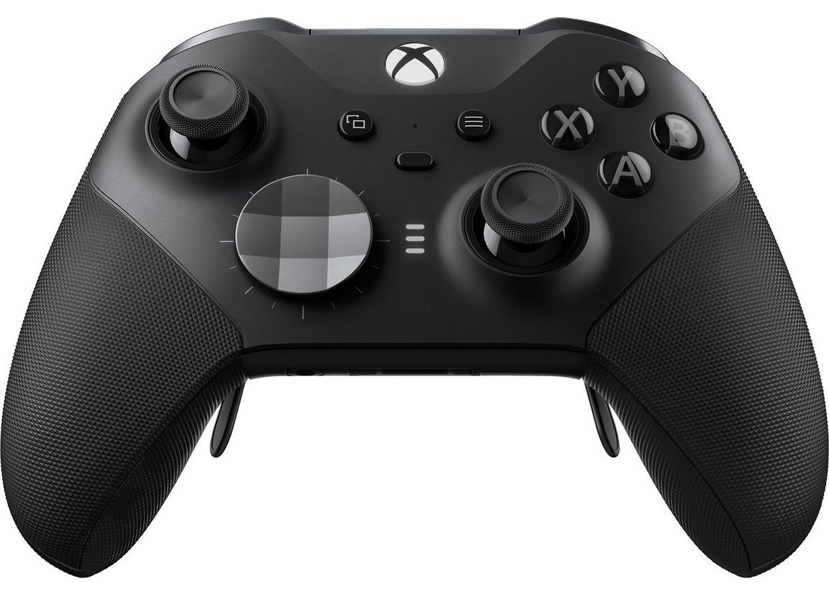
How to verify ?
Use the gamepad inputs to continuously verify the user.
Modern gamepads have very high precision input capability and a lot of different types of input like a normal button, analog stick, pressure sensitive triggers, touch surface etc.
The plan is to collect the state of these input types to distinguish the owner from an imposter.

Slide 4
But is it a biometric ?
Different people may differ in the way they use the gamepad, some of them are :
Speed of click and release of a button.
The hold time of triggers.
The pressure and speed of the trigger press.
Speed and angle of movement of an analog joystick.
The total movement of the whole controller.
The orientation of the gamepad (some gamepads have gyroscopes).

Slide 5
Data collection
Python script that records the input event from the controller.
Data collected for 3 people: 1 user and 2 imposters.
Data collected while playing the same game.
The game should have following characteristics :
It should be busy i.e. number of inputs per unit time is high.
It should not have a highly scripted gameplay.
All users should be equally familiar with the game.

Slide 6
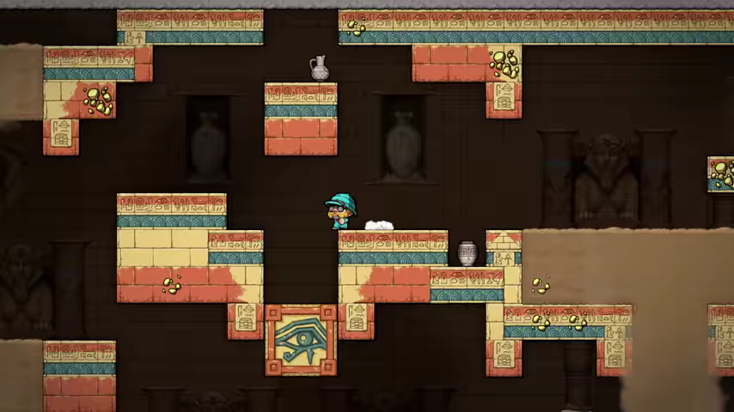
Spelunky 2

Slide 7
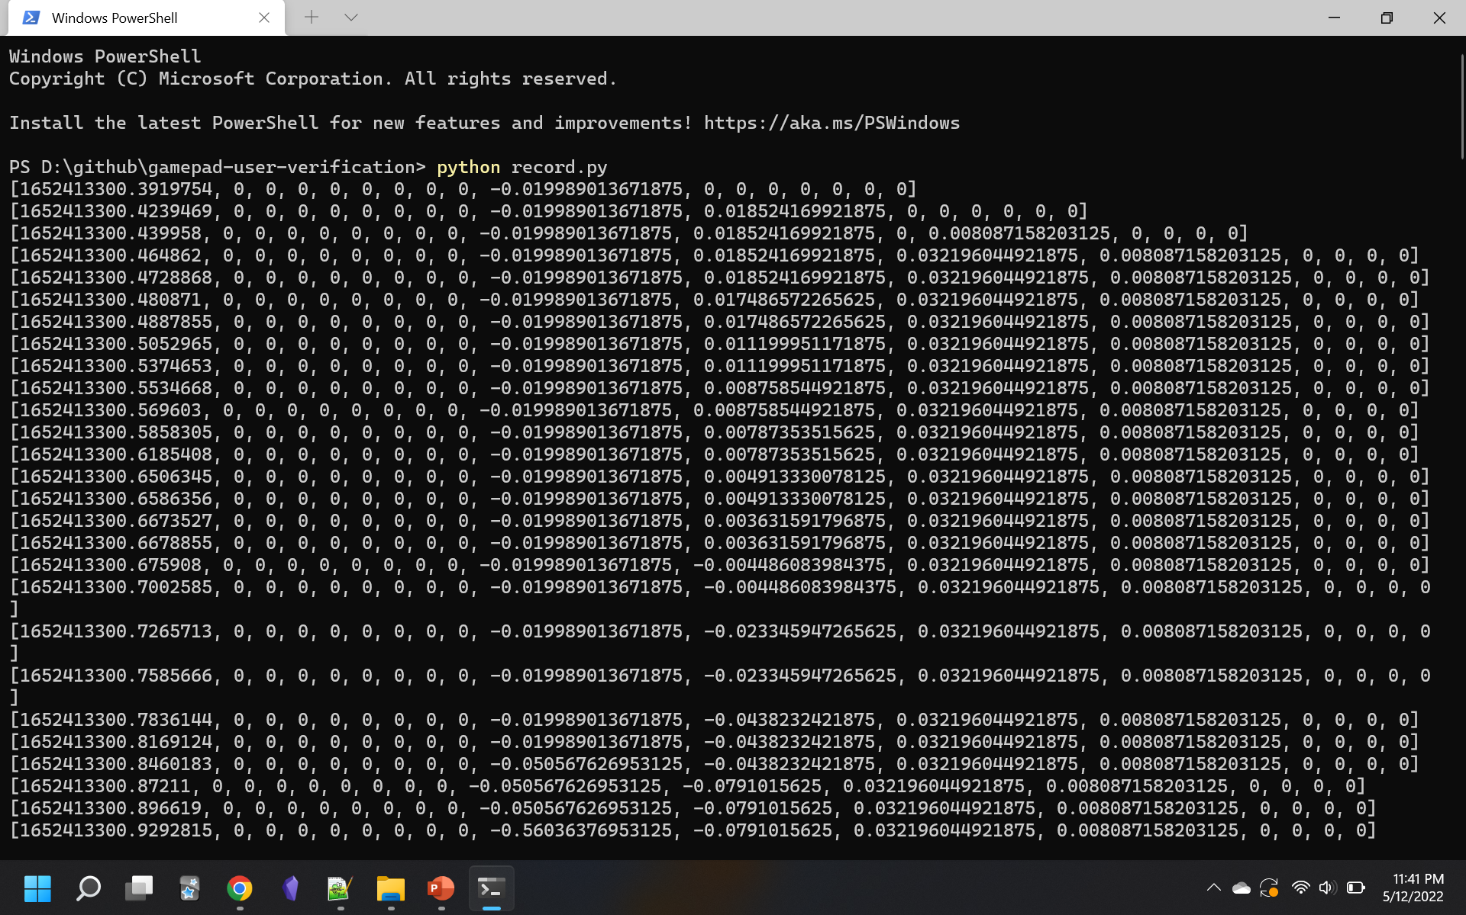
Raw data

Slide 8
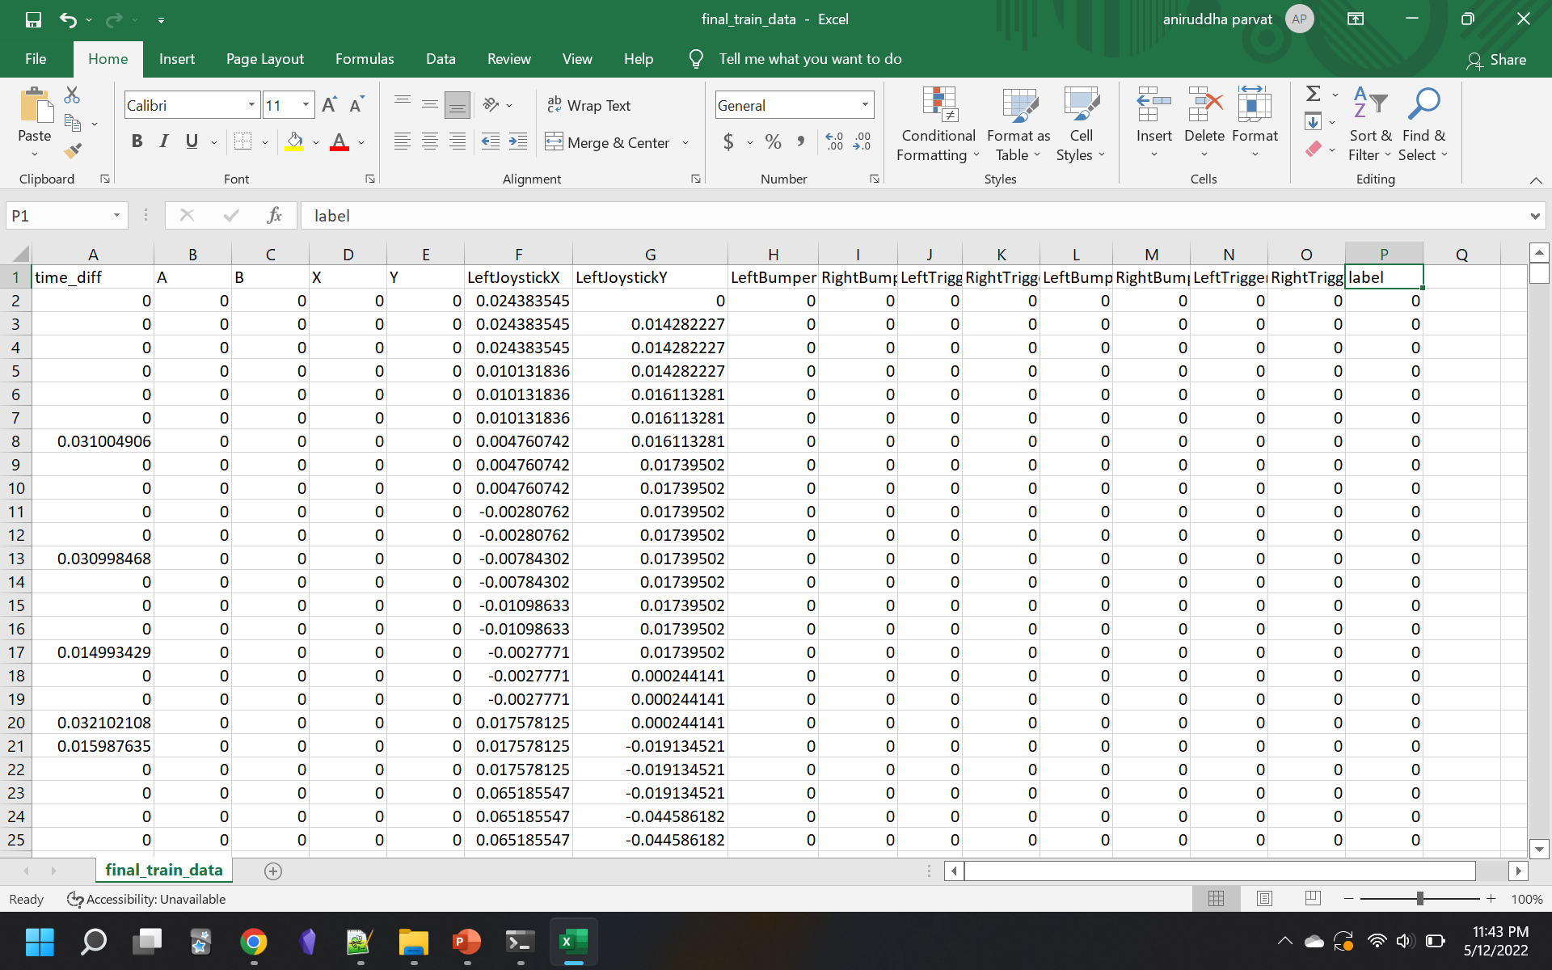
Processed data

Slide 9
Final dataset
After processing number of features : 15. From 18.
319998 final samples used to train a neural network. 50% imposter.
96652 final samples for testing.
Each sample has 720 rows because on average a 15 second recording has 720 rows
Lot more data was collected but not used because preprocessing and training of sequences require a lot of memory and processing power.
To keep the limited training data as required by the machine learning model requires 22.3 GB of memory but reading on demand is very time consuming.

Slide 10
Experiments and results
Python libraries used : inputs, NumPy, Pandas, TensorFlow, Keras.
A Long short-term memory neural network was trained.
2 layers each with 128 units and 20% dropout.
99% accuracy on training data.
83.47% accuracy on test data.
Could not do hyperparameter optimization because of limited computing resources.
Google Collab with GPU runtime.

Slide 11
Feasibility
The three most popular consoles right now : Nintendo Switch, Microsoft Xbox and the Sony PlayStation, have the same input schema, the orientation may be different. So a system designed with details of some system can be adapted with data to another system.
Each console comes with the same type controller so most people are likely to use that controller and not search for a second party controller. This means the vast majority of target hardware are similar.
All consoles also have very powerful single instruction, multiple data processors which are ideal for running modern machine learning models. Furthermore the hardware is fixed for each type of console so the verification system can be highly optimized for that hardware.

Slide 12
Pros
There are no other systems that do continuous user verification on consoles.
No extra hardware required.
The actual predicting phase is very fast i.e. microseconds.
Training can be speedup using transfer learning.
Easily extensible to all consoles.
Runs in background and user is not disturbed.
Almost no security concerns.

Slide 13
Cons
Not suitable for all types of users playing all types of games.
A player generally “gets good” at a game after some time and that may change the way they use the controller.
Needs a long term study.
What if the system is a shared system ?

Slide 14
Future work
Collect a lot more data.
Collect data during different activities.
Explore “junk inputs” as unique signature.
Handcrafting the features.
Following parameters can be tuned :
The poll rate of the controller to nanoseconds.
The length of sequences: currently 15 seconds or 720 rows.
Number of LSTM units in the network.
A context aware system may provide performance improvements.

Slide 15
Conclusion and contribution
Preliminary analysis of gamepad inputs as biometric : it is possible.
Code ready for large scale analysis.
https://github.com/aniruddha96/gamepad-user-verification

